Slide 1

The association between video game expertise and processing speed, task MIXING and SWITCHING in Counter-Strike players
Eleanor Hyde
Claudia von Bastian
Robert Schmidt
The University of Sheffield, UK

Slide 2
Action video games (AVGs)
Action video games
Cognition
Expertise
Notes:
I’ve been playing video games for over a decade, my parents considered them to be a bit of a waste of time – exciting shift in the literature, in which researchers are considering the possible benefits VG play may have on cognition.
CLICK
This gif shows the gameplay from the FPS game CS – and it gives some insight of the complex objects, goals, and environments that VGPs must keep track of during gameplay.
CLICK
So these FPS games, known as AVGs in the literature, are thought to challenge a range of cognitions, so the theory is: that if playing AVGs requires a range of cognitions, then there may be a potential for AVG play to improve some of these cognitive abilities.
Furthermore, if playing AVGs enhances cognition, perhaps these improvements are more prevalent in highly expert AVG players – who have become extremely skilled in through dedicated play and training.
And so it was the relationship between AVG play, cognition and expertise which was the focus of this research.

Slide 3

background
Processing Speed: general ability to process, understand and respond to information.
Dye, Green & Bavelier (2009) and Van Ravenzwaaij et al. (2014).
Task Mixing and Switching: executive function allowing us to perform several tasks at once (mixing) and switch between them (switching).
Cain, Landau & Shimamura (2012) and Green et al. (2012).
Notes:
Our research focused on three cognitive abilities: processing speed, task mixing and switching.
Processing speed is our general perceptual ability to process, understand and respond to information. Likely important during AVG play, as players must quickly process, and accurately respond to visual information.
CLICK
Small scale AVG training studies have had mixed results, with Dye finding that NVGPs who were trained for 50 hours in AVGs improved their processing speeds compared to controls, whilst a similar study which trained participants for a reduced period of 20 hours, found no improvements.
However, these differences in results may be due to methodological limitations – which I’ll come to shortly.
Task mixing and switching, otherwise known as multi-tasking, is an executive functions - which allow us to perform several tasks at once and switch between them. May be important during AVG play, as players must simultaneously respond to and switch between several in-game tasks.
CLICK
And there are some promising results from the limited AVG and task switching studies- finding improved task switching performance in AVG players however, this effect was largely due to improvements in RTs, so further research is necessary to understand the relationship between processing speed, task mixing and switching in AVG players.

Slide 4
BACKGROUND
Stricter definitions of AVGs
Measure of AVG expertise
Larger and more diverse samples
Longer training or more expertise
Counter-Strike (CS)
How to measure expertise?
N = 250+
10 to 10,000 total hours
Notes:
And there were some limitations in the previous studies which this study aimed to address.
Firstly, the definition of AVGs varies substantially between studies. Most refer to FPS games, whilst some include fighting games (Mortal Combat) or Racing Games (Mario Kart).
CLICK
When you look at Mario Kart here, it is a fast-paced game but the elements of this are very different to the CS clip I showed earlier.
Different game genres have very different elements, and likely challenge different aspects of cognition. So, it’s important that researchers well-define the VG genre they’re investigating first.
In this study, our definition of AVG was very specific, we chose to investigate the cognitive performance of CS players only.
CS is one of the most popular and longest running free-to-play AVG games, and it’s also played at the competitive eSports level. Meaning we can observe cognitive performance in some of these super expert players compared to more novel players of the same game.
Secondly, AVG expertise is often measured with a self-rated score or report of weekly hours playtime - with typical classification of an AVG player being someone who plays 5 hours of AVGs per week. But this doesn’t capture those who play AVGs much more frequently than that.
We aimed to establish some quantitative measures which would well reflect the range AVG expertise from novices to professional eSport players.
Additionally, studies with larger samples are always necessary in cognitive research, especially with cross-sectional investigations which require large samples for findings to have reasonable power. A sample size of 250 was our aim, based on simulations which show correlations to stabilise around this level.
Finally, previous training studies have trained participants in AVGs for periods of 10-50 hours however, in the real-world, many VGP achieve that level of playtime every single week. Perhaps to see a real effect on cognition we need to train participants for longer periods than 50 hours.
Whilst we’re unfortunately not able to sit someone in a lab and train them for 10,000 hours – we can observe the cognitive performance differences in novices and professional eSports players, which we aimed to do in this study.

Slide 5
Study 1: Interviews
Participants: three CS players who self-identified as being a casual, expert or professional player.
Player statistics:
Total hours playtime: 2,000, 2,000, 10,000.
Weekly hours playtime: 0, 58, 100.
Measures of Expertise:
Total hours playtime
Weekly hours playtime
Self-rated expertise
Notes:
But before we started our cross-sectional investigation, we had an important question to answer which was - ‘how do we measure expertise is CS players?’
So, we asked three experts, in an hour-long interview, talked about a range of topics such as player statistics, and importantly, how they discerned expertise amongst CS players themselves.
CLICK
What we found was that our three interviewees ranged vastly in two player statistics shown here, and when we asked participants, they each stated that their total hours playtime and weekly dedication to the game would be important markers of expertise.
CLICK
So we included these two statistics in our measure of expertise - participants also had another suggestion, and this was current ranking.
Within CS there’s an in-built ranking system, where you gain points when you perform well during competitive games, and move up or down these ranks based on how well (or not well) you continue to do.
Took advantage of this in-built measure of expertise from within the game, in the next step of our study.
CLICK
Finally, as I said before, the VG literature often uses two measures of AVG expertise which are: weekly hours of playtime and self-rated expertise.
So, self-rated expertise was also used in the cross-sectional study – where we used a questionnaire to establish participants expertise level based on these four measures.

Slide 6
Study 2: Cross-sectional
Participants: n = 273
- 91% male, 8% female and 1% non-binary/other.
- Age: M = 22.21, SD = 4.77.
Method: online-study ≈30 minutes
Colour/shape task via Tatool software (von Bastian, Souza & Gade, 2016) which measured cognitive outcomes.
Questionnaire via Qualtrics software (Qualtrics, Provo, UT) measuring CS expertise and experiences.
Notes:
So, the purpose of this cross-sectional study was to examine processing speed, task mixing and switching performance in varyingly expert CS players.
For this we recruited players via social media, achieving a final sample of 273 individuals, who were predominantly male, with an average age of 22 years old.
CLICK
Participants completed an online study: colour/shape task which measured our cognitive outcomes, followed by a questionnaire which included our four measures of expertise, along with some additional questions such as their playstyle or tournament participation.

Slide 7
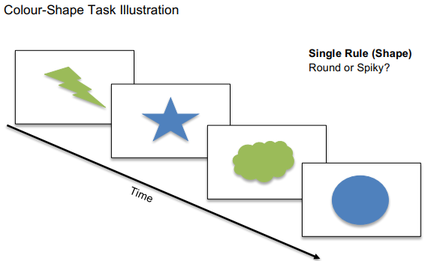
Colour/Shape Task
Three Blocks:
Single-rule 1: shape then colour
Mixed-rule: switching from shape and colour
Single-rule 2: colour then shape
Within the Mixed-Rule Block:
Repetition trials: same rule in successive trials
Switch trials: rules changed from preceding to current trial
Notes:
In the colour/shape task, participants were presented with simple objects which they had to identify in terms of their shape (round or spiky) or their colour (blue or green) - as quickly and as accurately as possible with a key press.
CLICK
Objects were presented in three blocks:
Single rule blocks - identified objects as shape, then colour
Mixed rule block - rules switched between trials from shape to colour, colour to shape.
Another Single rule block – rules presented in the reverse from the first single rule block, colour then shape.
CLICK
Within the mixed rule block there were two types of trials:
Repetition - same rule was presented in successive trials (shape then shape)
Switch trials - rule changed from the preceding to the current trial (shape then colour)
Total of 385 trials were presented to participants.

Slide 8
Colour/Shape Task
Processing Speeds: average RT in single-rule trials.
Mixing Costs: RT difference between single-rule trials and repetition-rule trials (mixed block).
Switching Costs: RT difference between repetition-rule trials and switch-rule trials (mixed block).
Notes:
We obtained three measures of cognitive performance from this task.
Frist, processing speed was measured as the average RT in single-rule trials.
CLICK
Mixing Costs: reflected the RT difference between single-rule trials and repetition-rule trials from the mixed block.
CLICK
Switching Costs: reflected the RT difference between repetition-rule trials and switch-rule trials from the mixed block.

Slide 9
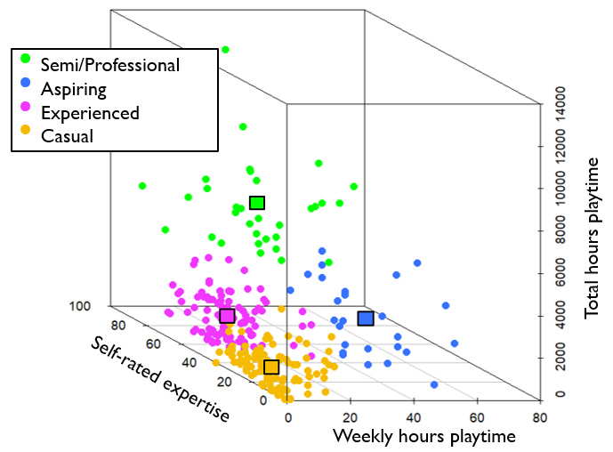
cluster analysis Results
Semi/Professional
Aspiring
Experienced
Casual
Notes:
K-means cluster analysis takes the data from our 3 expertise variables and weighs them all equally against each other, sorting participants into cluster groups based on similarities on these measures.
We used a consensus-based algorithm plot, to determine the number of cluster groups which would best describe our data – and this suggested that four groups would be the best fit.
CLICK
We named these groups Casual, Experienced, Aspiring and Semi/Professionals, with the majority of players, 78% of them, sitting in these two lower expertise categories.
The cluster group names were chosen by researchers based on the mean values of each group which I’ll come to in a second.
CLICK
This cluster plot has three axes, X = weekly hours playtime, Y = self-rated expertise, Z = total hours playtime.
Each circle point represents a participant, who are colour coded based on their cluster group allocation, and the squares represent the means for each cluster group.
Taken together, these three measures well describe expertise levels amongst our participants - who ranged vastly in CS expertise.
Casual players had the lowest values for each expertise measure, Experienced players had around double the expertise of Casual players, Semi/professionals had the highest values for self-rated expertise and total hours playtime – whilst Aspiring players have similar levels of expertise to the Experienced players, but also have the highest values for weekly hours playtime – suggesting they dedicate a lot more of their week to CS than other players.

Slide 10
Mean speeds across Expertise cluster groups
***
*
***
**
Notes:
So, how do these four expertise groups differ in terms of their cognitive performance on our colour/shape task?
Critically, we found that RTs in single-rule trials were fastest in those with greater expertise – suggesting processing speed performance is enhanced in more expert CS players. And an ANOVA revealed this relationship to be significant.
Experienced players were 48ms faster than Casual players, and Semi/Professionals were 85ms faster than Casual players – and pairwise t-tests showed both of these relationships to be significant.
As we’d expect, RTs were slower overall in Repetition-rule trials, as they are in the more challenging Mixed-rule block – and again RTs were fastest in those with greater expertise, with the ANOVA revealing this relationship to be significant.
However, on Switch trials, RTs were fastest in Experienced players, with Aspiring and Semi/Professionals second best, and Casuals being the slowest in these trials. Whilst we would expect RTs to be slower in these more challenging Switch trials, there appears to be a U-shaped relationship here – but evaluation of the mixing and switching costs will give more insight into this.

Slide 11
Mean costs across expertise cluster groups
Notes:
Mixing Costs reflects our ability to do two tasks simultaneously, and performance was very similar across participants. There was a difference of just 10ms between the largest cost in Casuals and the smallest cost in Experienced players – so no relationship here.
Then we have Switching Costs, which reflects our ability to switch between tasks, and performance was best in Experienced players who showed the smallest switching costs, and Semi/Professionals had the worst performance, showing the greatest switching costs. And whilst there was a difference of over 100ms between these two values – the ANOVA revealed this U-shaped relationship to be non-significant.

Slide 12
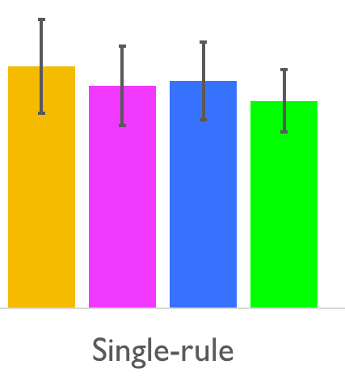
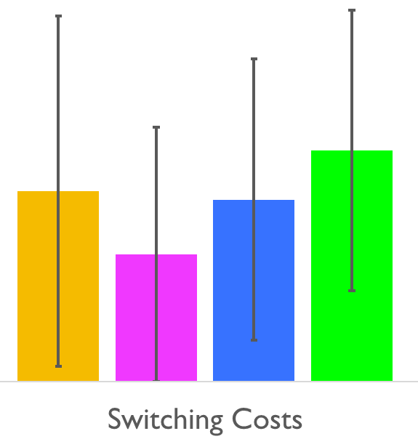
summary
Processing speed abilities were enhanced in highly expert CS players.
Supports: Dye, Green & Bavelier, 2009 and Green et al., 2012.
Further Investigations: large interventions with long training periods.
Mixing and switching performance was not enhanced in highly expert CS players.
Schenk et al. (2020) eye-tracking of AVG players during a cognitive task, AVG players use different stimulus exploration strategies.
Explanation: expert players use a focused attentional strategy, less expert players, use a divided attentional strategy.
Notes:
In summary, our results suggest that processing speed abilities are enhanced in more expert CS players, as reflected by the relationship between speed in single-rule trials and CS expertise.
CLICK
This supports previous literature, and suggests that playing AVGs could improve processing speed abilities however, further intervention studies are necessary to imply causality.
CLICK X2
Secondly, mixing and switching performance was not enhanced in more expert CS players.
Whilst this finding was non-significant, the U-shaped relationship between CS expertise and switching costs is certainly interesting – and perhaps suggests that with expertise gains there are strategic shifts in attention allocation.
CLICK
A recent study, study which measured EEG signals and eye-movements in AVGs whilst they performed a cognitive task - suggested that AVGs have different stimulus exploration strategies, and improved early perceptual analysis of stimuli.
CLICK
A similar conclusion could be applied to this study – perhaps highly expert players have reduced task mixing and switching ability, because they use a more focused attentional strategy compared to less expert players who employ a more divided attentional strategy.
However, as these findings are non-significant – further research is required to establish a relationship between mixing and switching ability in AVG players.

Slide 13
Conclusions
Large scale cross-sectional investigation of processing speed, mixing and switching performance in varyingly expert CS players.
Improved method: small samples of casual AVG players.
Quantify CS expertise with a novel multivariable measure and k-means cluster analysis method.
Applied to other well-defined AVGs in future investigations.
Improvement: single measure of AVG expertise.
Notes:
We conducted a large-scale cross-sectional investigation of processing speed, mixing and switching performance in CS varyingly expert CS players, an improvement on the typically small samples found in the AVG literature.
CLICK
Furthermore, we quantified CS expertise using a novel multivariable measure and k-means cluster analysis method.
This methodology could be applied to other well-defined AVGs in future investigations, and is an improvement on previous studies who have often relied on a single measure of AVG expertise.

Slide 14
Next steps
Drift Diffusion Model (DDM) on reaction time distributions (Ratcliff, 1987).
Allows decomposition of observed RTs and accuracy scores into decision making processes.
Future Study: why do CS players have improved processing speed performance, in terms of the ‘Learning to Learn’ theory and possible enhancements in probabilistic inference.
Notes:
This research has implications in terms of improving processing speed abilities with AVG play however, more research into the longevity and transferability of AVG trained cognitive skills to everyday-life is necessary.
CLICK
The next steps for this data-set is to conduct Drift Diffusion Modelling on the reaction time distributions – this decomposes the observed RTs and accuracy scores into latent decision-making processes, such as drift rate.
CLICK
Following this, our next study aims to address why CS players have improved processing speed, in terms of the ‘learning to learn’ theory and possible enhancements in probabilistic inference due to CS expertise.

Slide 15

Thank you!
Eleanor Hyde
ERAHYDE1@SHEFFIELD.AC.UK
The University of Sheffield, UK
Dr Claudia von bastian
c.c.vonbastian@SHEFFIELD.AC.UK
The University of Sheffield, UK
Dr Robert schmidt
Robert.Schmidt@sheffield.ac.uk
The University of Sheffield, UK
Notes:
Finally, I’d like to say thank you to my participants, my supervisors and of course this lovely audience for listening to my presentation. Thank you.

Slide 16
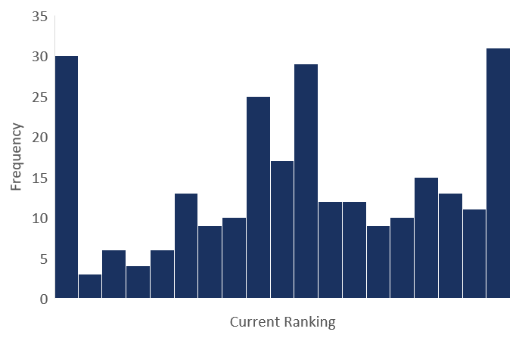
Questionnaire results
Measures of Expertise:
Total hours playtime
Weekly hours playtime
Current ranking
Self-rated expertise
Unranked (1)
Global Elite (19)
Gold Nova Master (11)
Gold Nova II (9)
Notes:
When we obtained the data, we first considered the values from our four measures of expertise.
CLICK
But when we looked at the current ranking data, we realised that a large proportion of participants had sated they did not have a current ranking in the CS ranking system.
Answers to other questions from the questionnaire revealed that this was because they were using other ranking systems such as ESEA or FACE IT, which go well-beyond the highest ranking of Global Elite in the in-build system.
CLICK
So these highly expert players, and players who did not currently hold a ranking from competitive gameplay – weren’t well represented by the current ranking measure.
Unfortunately, this measure was not considered in the next steps of our analysis – left us with these three measures of expertise.

Slide 17
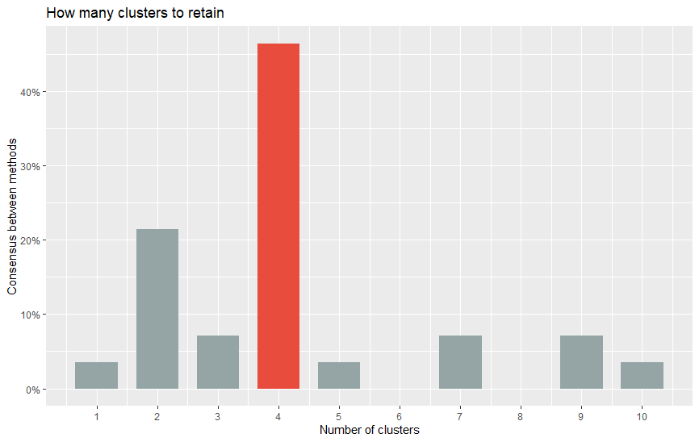
Consensus-based algorithm plot
Takes data from our three expertise variables and weighs them all equally against one another.
Sort participants into cluster groups based on their similarities on these measures.
Indicates how many cluster groups participants would be best allocated to as a balance between minimizing the number of cluster groups and minimizing the variance within each cluster.

Slide 18
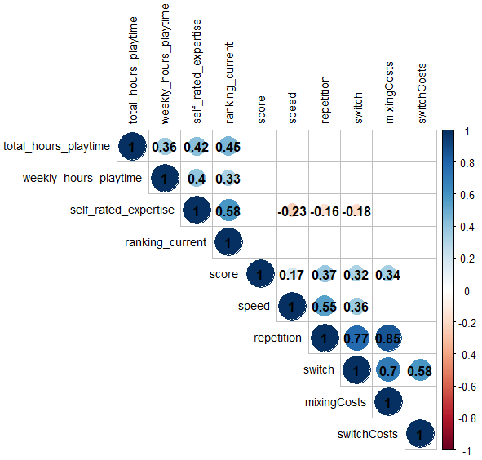
Zero order correlations
Zero-order correlations

Slide 19
Zero-order correlations
Descriptive statistics

Slide 20
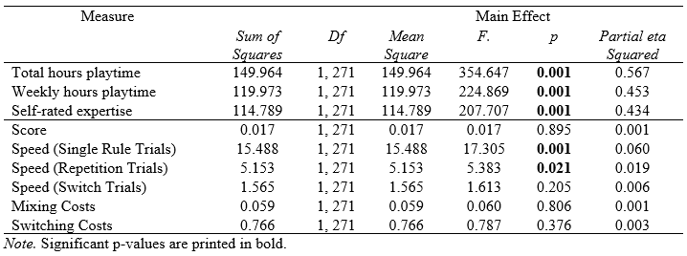
Zero-order correlations
Main effects: expertise cluster group x cognitive outcomes

Slide 21
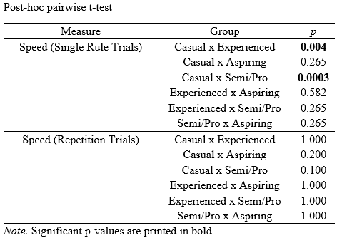
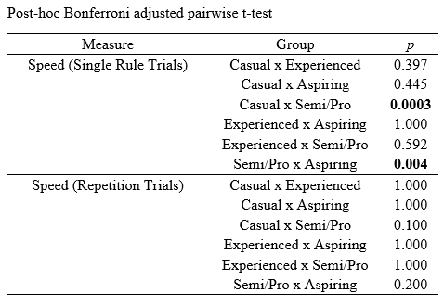
Zero-order correlations
Pairwise T-tests

